Slide 1
The UN Convention and My Rights
The laws and agreements about your rights

Slide 2
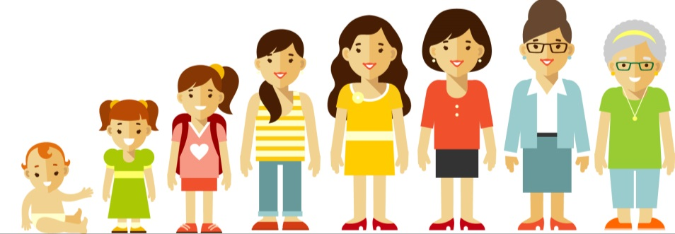
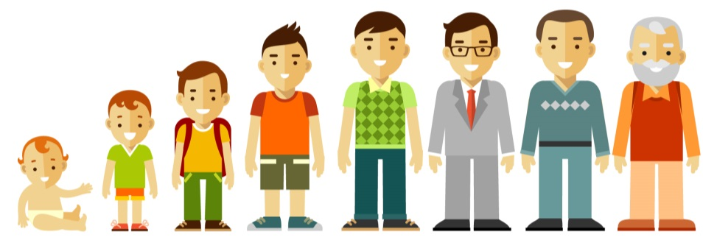
Everybody in the world should have rights. From when they are born till when they die.

Slide 3
Everybody should know that they have rights.

Slide 4
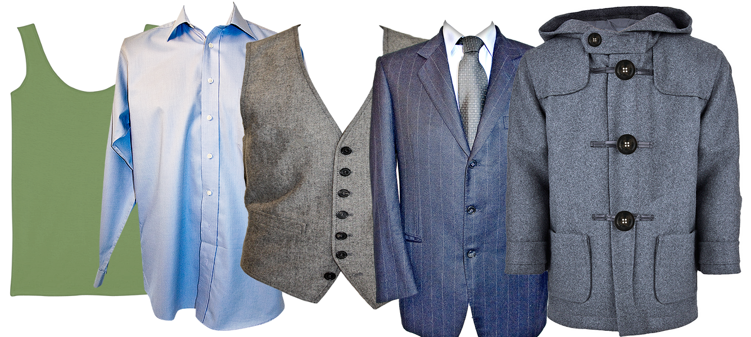
There are different laws to protect us all from being treated unfairly.
You can think of the laws like layers of clothes.

Slide 5

We are all protected by the Human Rights Act 1998.
This was based on a Declaration from the United Nations in 1948.

Slide 6

If you are under 18 you are protected by the Children Act and the United Nations Convention on the Rights of the Child.

Slide 7

If you have a learning disability you are also protected by the United Nations Convention on the Rights of Persons with Disabilities 2006.

Slide 8

In Wales we have Social Services and Well-being Act (2014) to help you
  Be healthy
  Be happy
  Have opportunities to learn new things
  Be in control of your life
  Have a chance to work

Slide 9
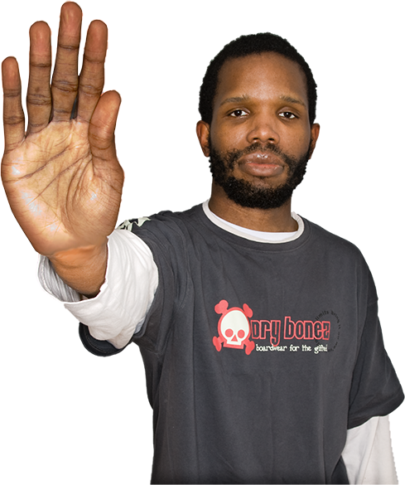
If someone tries to stop you from getting your rights …they are wrong!

